Slide 1
COMPUTER NETWORKS

Slide 2
A network
is a set of devices (often referred to as nodes) connected by communication links. A node can be a computer, printer, or any other device capable of sending and/or receiving data generated by other nodes on the network.
Data communications-
are the exchange of data between two devices via some form of transmission medium such as a wire cable.
Data Representation-
Information today comes in different forms such as text, numbers, images, audio, and video.
Network Criteria- Performance, reliablity, security
Internetwork
Interconnection of Networks:

Slide 3
Effectiveness
Delivery. The system must deliver data to the correct destination
Accuracy. The system must deliver the data accurately. Data that have been altered in transmission and left uncorrected are unusable
Timeliness. The system must deliver data in a timely manner. Data delivered late are useless
Jitter. Jitter refers to the variation in the packet arrival time. It is the uneven delay in the delivery of audio or video packets. For example, let us assume that video packets are sent every 3D ms. If some of the packets arrive with 3D-ms delay and others with 4D-ms delay, an uneven quality in the video is the result.

Slide 4
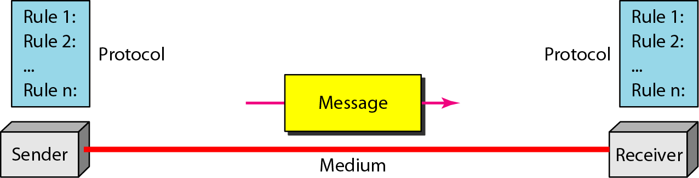
Components
Message. The message is the information (data) to be communicated. Popular forms of information include text, numbers, pictures, audio, and video.
Sender. The sender is the device that sends the data message. It can be a computer, workstation, telephone handset, video camera, and so on
Receiver. The receiver is the device that receives the message. It can be a computer, workstation, telephone handset, television, and so on
Transmission medium. The transmission medium is the physical path by which a message travels from sender to receiver
Protocol. A protocol is a set of rules that govern data communications. It represents an agreement between the communicating devices.

Slide 5
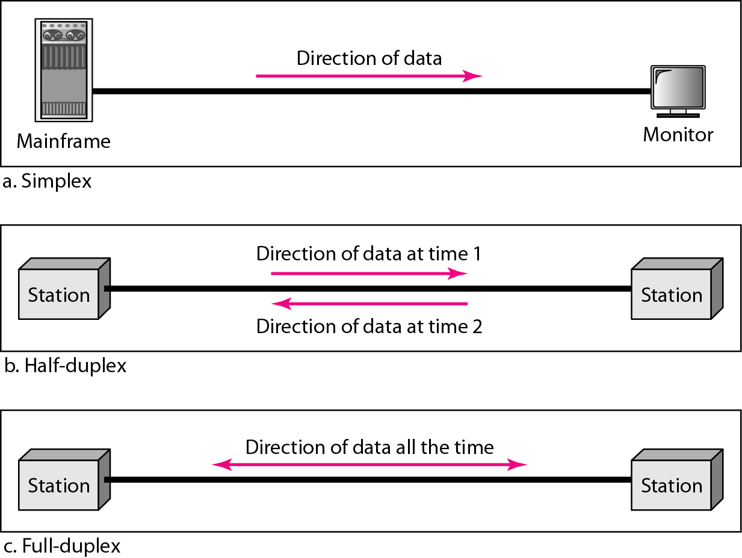
Transmission Modes/Data flow
Simplex mode- the communication is unidirectional, as on a one-way street. Only one of the two devices on a link can transmit; the other can only receive
Half-duplex mode- each station can both transmit and receive, but not at the same time. : When one device is sending, the other can only receive, and vice versa
Full-duplex - both stations can send and receive simultaneously

Slide 6
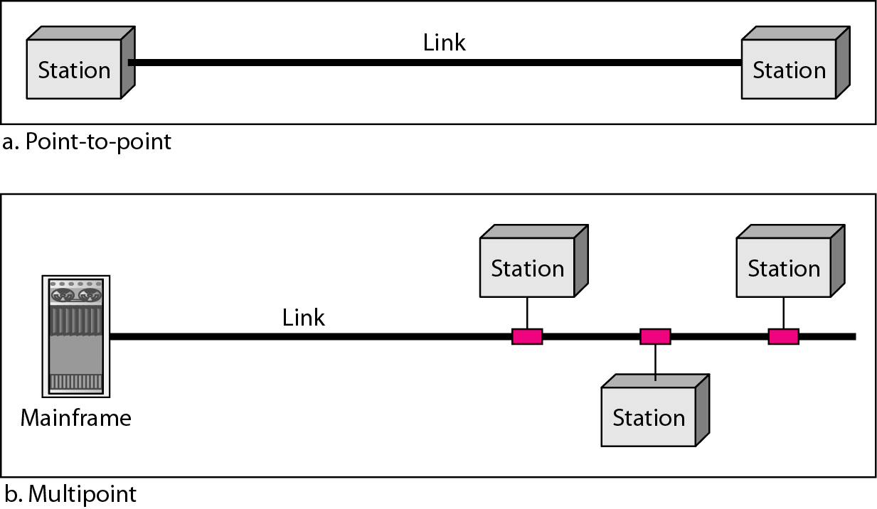
Type of Connection/Line configuration
A network is two or more devices connected through links. A link is a communications pathway that transfers data from one device to another.
Point-to-Point A point-to-point connection provides a dedicated link between two devices. The entire capacity of the link is reserved for transmission between those two devices.
Multipoint A multipoint (also called multidrop) connection is one in which more than two specific devices share a single link

Slide 7
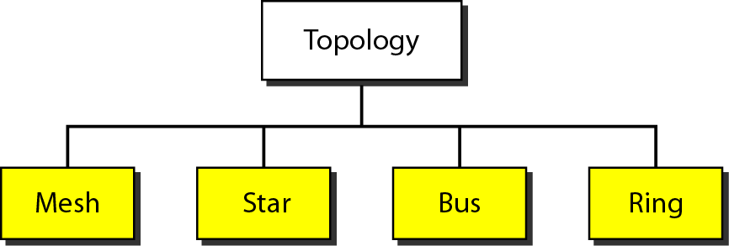
Topology
Physical Topology-The term physical topology refers to the way in which a network is laid out physically

Slide 8
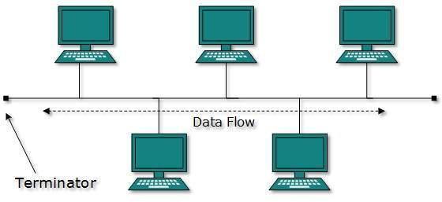
Bus topology -In case of Bus topology, all devices share single communication line or cable. Bus topology may have problem while multiple hosts sending data at the same time. Nodes are connected to the bus cable by drop lines and taps. A drop line is a connection running between the device and the main cable.
Advantage
Ease of installation
Cheap
Disadvantage
Difficult reconfiguration and isolation
A fault or break in the bus cable stops all transmission

Slide 9
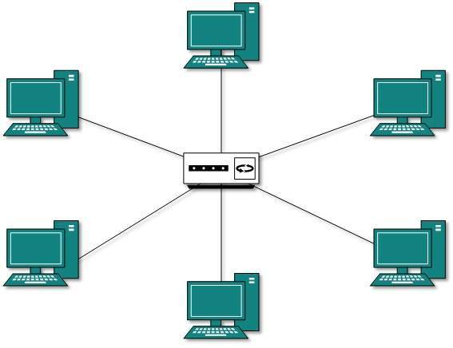
Star Topology
In a star topology, each device has a dedicated point-to-point link only to a central controller, usually called a hub. The devices are not directly linked to one another.
If one device wants to send data to another, it sends the data to the controller, which then relays the data to the other connected device
Advantage-
Less Expensive than mesh topology
Easy to install and reconfigure
Robustness
Fault identification easy
Disadvantage
More cabling than ring, bus

Slide 10
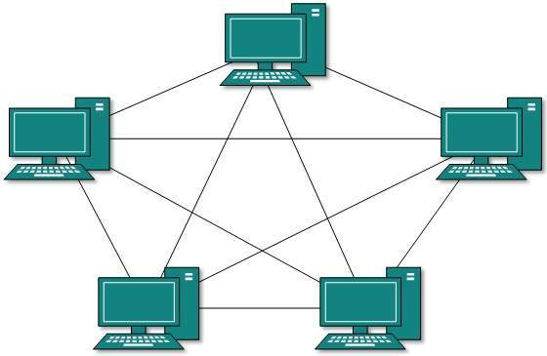
Mesh Topology
In a mesh topology, every device has a dedicated point-to-point link to every other device. The term dedicated means that the link carries traffic only between the two devices it connects. To find the number of physical links in a fully connected mesh network with n nodes, we first consider that each node must be connected to every other node. n(n-1)/2
Advantage-
No traffic problems
Robust(reliable)
Privacy and security
fault identification is easy
Disadvantage-
Installation and reconfiguration are difficult
Expensive

Slide 11
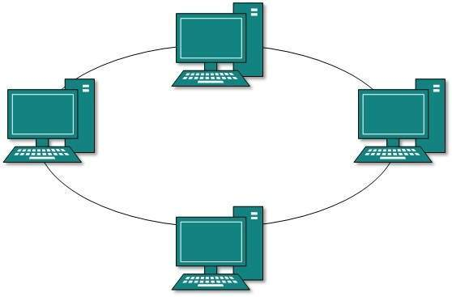
Ring Topology
In a ring topology, each device has a dedicated point-to-point connection with only the two devices on either side of it. A signal is passed along the ring in one direction, from device to device, until it reaches its destination. In ring topology, each host machine connects to exactly two other machines, creating a circular network structure.
Advantage-
Easy to install and reconfigure
Fault isolation is simplified
Disadvantage
Unidirectional traffic
Break in the ring can disable the entire network

Slide 12
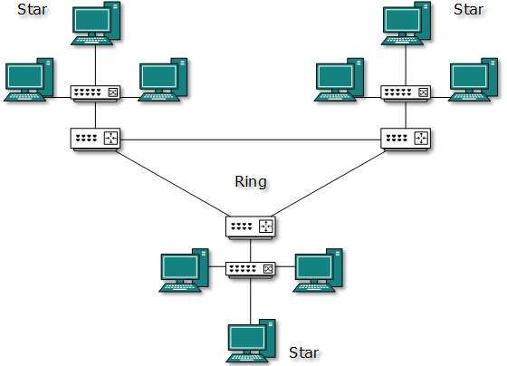
Hybrid Topology
A network can be hybrid. A network structure whose design contains more than one topology is said to be hybrid topology. Hybrid topology inherits merits and demerits of all the incorporating topologies.

Slide 13
Categories of Network
Local Area Network
A local area network (LAN) is usually privately owned and links the devices in a single office, building, or campus
Currently, LAN size is limited to a few kilometers.
Wide Area Network
A wide area network (WAN) provides long-distance transmission of data, image, audio, and video information over large geographic areas that may comprise a country, a conti• nent, or even the whole world.
The switched WAN connects the end systems, which usually comprise a router (internet• working connecting device) that connects to another LAN or WAN. The point-to-point WAN is normally a line leased from a telephone or cable TV provider that connects a home computer or a small LAN to an Internet service provider (lSP).
Metropolitan Area Networks
A metropolitan area network (MAN) is a network with a size between a LAN and a WAN. It normally covers the area inside a town or a city. It is designed for customers who need a high-speed connectivity, normally to the Internet, and have endpoints spread over a city or part of city. A good example of a MAN is the part of the telephone company network ,cable TV
Campus Area Network (CAN)
Personal Area Network (PAN)
Home Area Network (HAN)

Slide 14
Protocols and Standards
A protocol is a set of rules that govern data communications. A protocol defines what is communicated, how it is communicated, and when it is communicated. The key elements of a protocol are syntax, semantics, and timing.
Syntax. The term syntax refers to the structure or format of the data, meaning the order in which they are presented. For example, a simple protocol might expect the first 8 bits of data to be the address of the sender, the second 8 bits to be the address of the receiver, and the rest of the stream to be the message itself.
Semantics. The word semantics refers to the meaning of each section of bits.
How is a particular pattern to be interpreted, and what action is to be taken based on that interpretation? For example, does an address identify the route to be taken or the final destination of the message?
Timing. The term timing refers to two characteristics: when data should be sent and how fast they can be sent. For example, if a sender produces data at 100 Mbps but the receiver can process data at only 1 Mbps, the transmission will overload the receiver and some data will be lost.

Slide 15
Standards
Standards are essential in creating and maintaining an open and competitive market for equipment manufacturers and in guaranteeing national and international interoperability of data and telecommunications technology and processes. Standards provide guidelines to manufacturers, vendors, government agencies, and other service providers to ensure the kind of interconnectivity necessary in today's marketplace and in international com• munications. Data communication standards fall into two categories: de facto (meaning "by fact" or "by convention") and de jure (meaning "by law" or "by regulation").
De facto. Standards that have not been approved by an organized body but have been adopted as standards through widespread use are de facto standards. De facto standards are often established originally by manufacturers who seek to define the functionality of a new product or technology.
De jure. Those standards that have been legislated by an officially recognized body are de jure standards

Slide 16
Standards Organizations
ISO
International Organization for Standardization (ISO).
ITU-T
International Telecommunication Union-Telecommunication Standards Sector American National Standards Institute (ANSI).
IEEE
Institute of Electrical and Electronics Engineers (IEEE).
EIA
Electronic Industries Association (EIA).
Internet Standards
An Internet standard is a thoroughly tested specification that is useful to and adhered to by those who work with the Internet. It is a formalized regulation that must be fol• lowed. There is a strict procedure by which a specification attains Internet standard status. A specification begins as an Internet draft. An Internet draft is a working docu• ment (a work in progress) with no official status and a 6-month lifetime. Upon recom• mendation from the Internet authorities, a draft may be published as a Request for Comment (RFC).

